Slide 1
VOCATIONAL TRAINING PRESENTATION
On
Terror spy using java(J2SE)
At
Feasible Research & Technologies Pvt. Ltd.
Presented by:
Abhishek Tandon CSE- 5th sem
(303302216005)
Vaibhav Biturwar
(303302216076)

Slide 2
Index
Introduction
H/W and S/W requirements
Front-end & Back-end
Analysis
Design
Snapshots
Applications
Further scope

Slide 3

INTRODUCTION:
It monitors users activity.
Records keystroke for active window.
Identifies terrorist activities.
It will inform authorities about suspicious users.

Slide 4
Software Requirements
Windows 10, 8x, 7
Java 1.8 or Higher
Xampp v3.3.2 or higher

Slide 5
Hardware requirements
Requires minimum 128 MB of RAM
Diskspace 256 MB
Processor Intel pentinum or equivalent

Slide 6


Front-end & back-end
Front End
Back End

Slide 7
analysis
The purpose of this project is to inform the higher authorities before handed about any suspicious activity being planned.
Whenever somebody harms the society with evil activities, our authorities don’t have that much facilities or sources to avoid them without any damage being caused. They take actions aftermath but it doesn’t have any impact on life of other people.
But think if a platform is provided where Authorities get power to get acknowledged about these activities before happening. It really can help change our future.

Slide 8
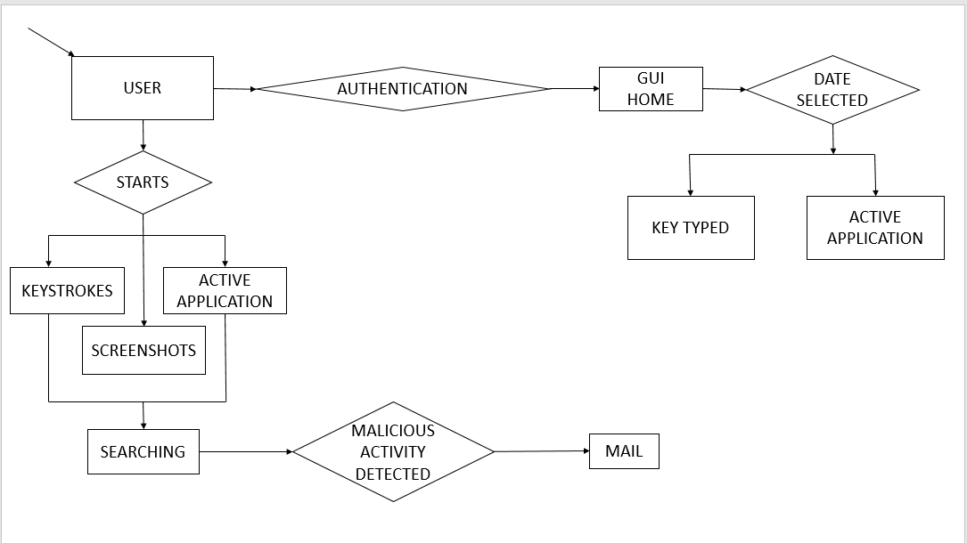
Design (flowchart)

Slide 9
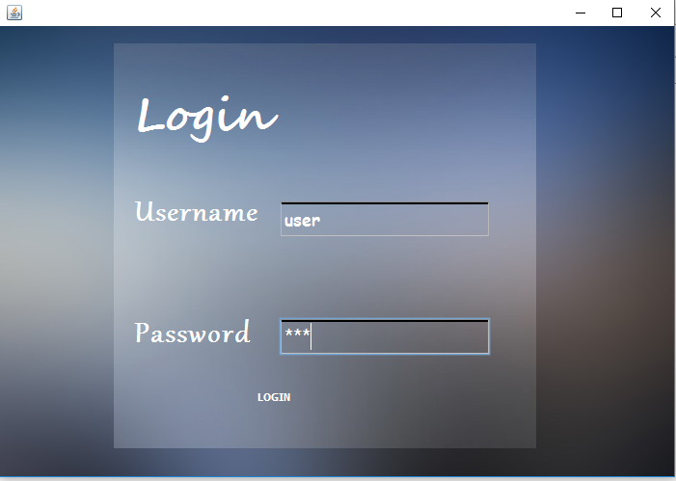
SNapSHOTs

Slide 10
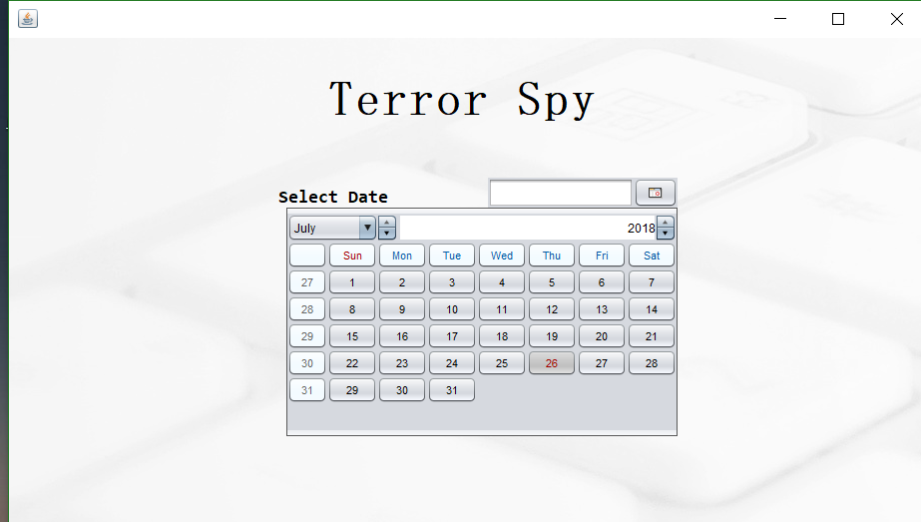

Slide 11
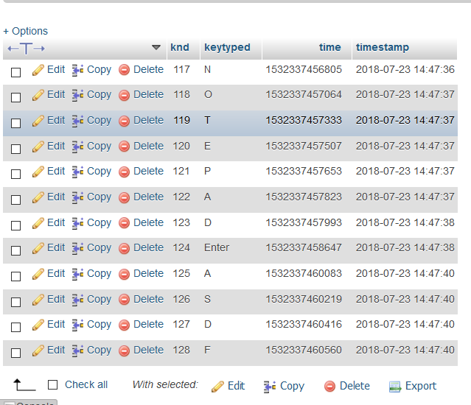

Slide 12
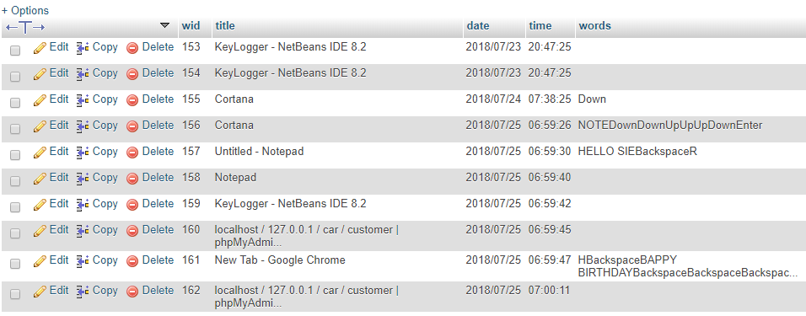

Slide 13
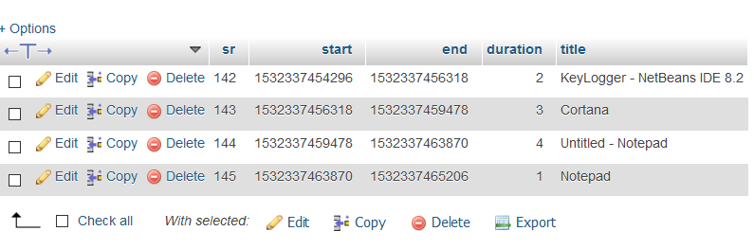

Slide 14
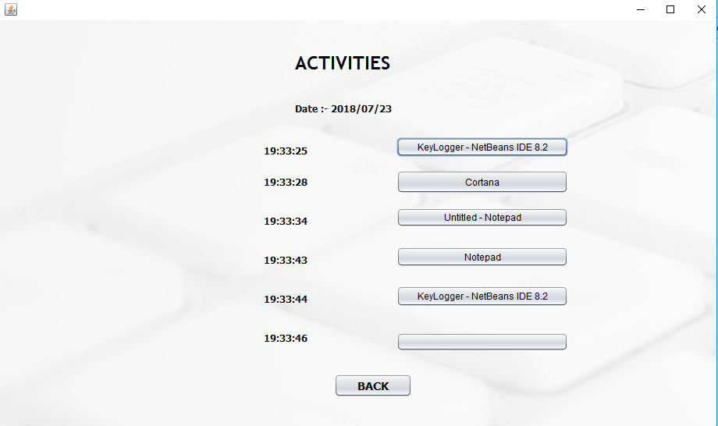

Slide 15
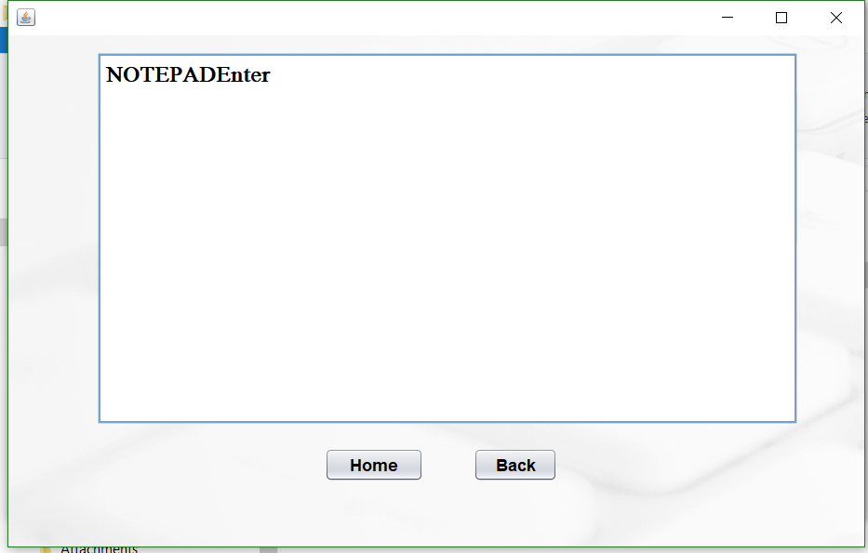

Slide 16
applications
Security From mentally retarded person
In an organization higher authority can keep eye on lower level
It will help govt. agencies to keep eye on suspects

Slide 17
Further scope
It can be implemented by operating system.
Remote Access.

Slide 18


